Slide 1

Time Series project – Sydney airport traffic
Alberto Monari - Kevin Da Silva - Louise Dietrich

Slide 2
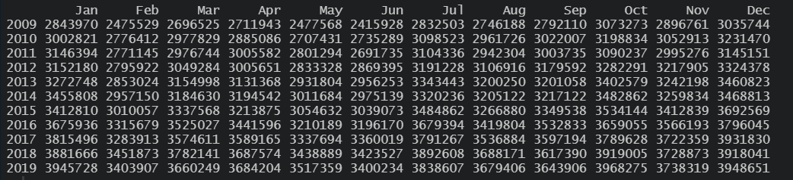
Dataset description
Our dataset consists of 132 observations;
The period studied is from January 2009 to December 2019 and the frequency is monthly;
Each observation is therefore characterized by a year, a month and a whole number of passengers who passed through the Sydney airport in that month;
Our goal is to predict the number of passengers each month of 2020 in the Sydney airport.

Slide 3
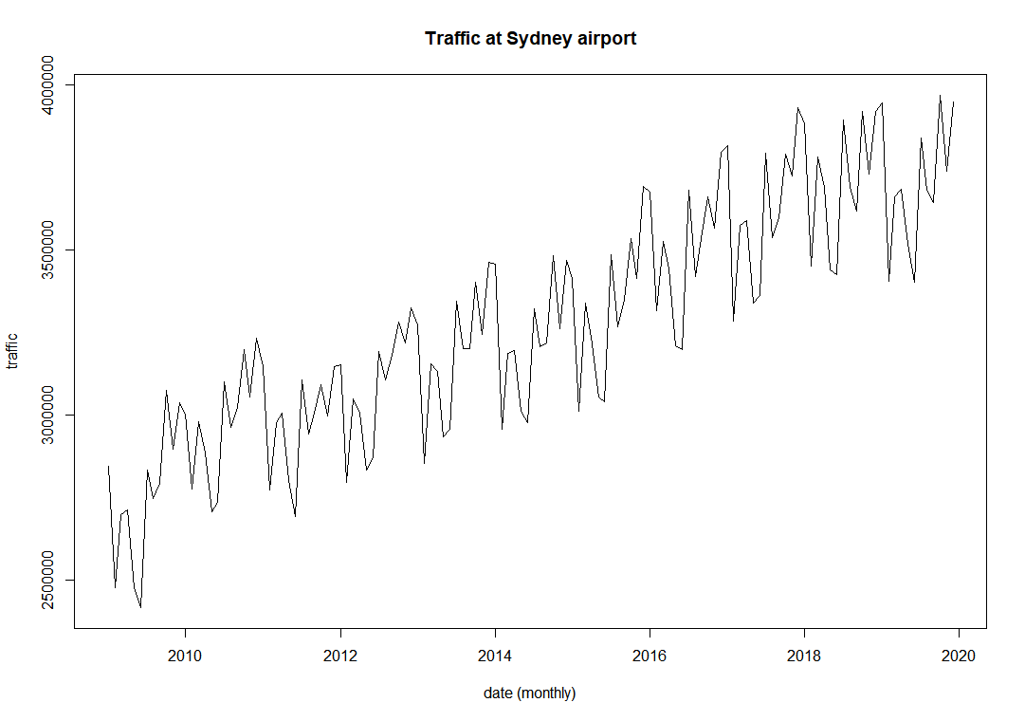
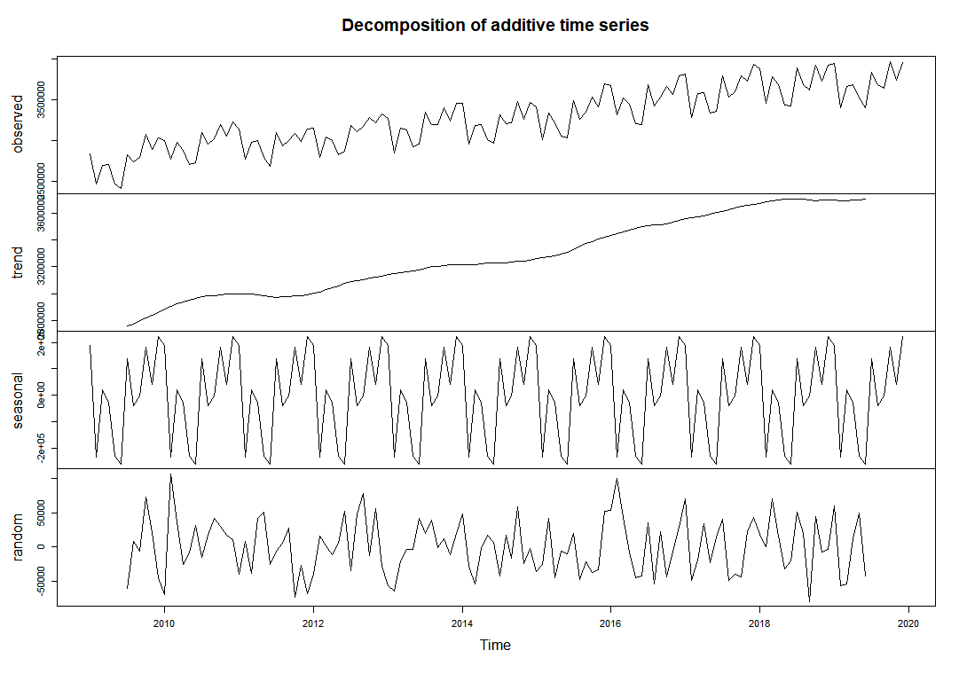
Time series description
Trend: there is a long-term linear increase
Seasonality: there is seasonality because a certain pattern is repeating every year
Random: there is a random component

Slide 4
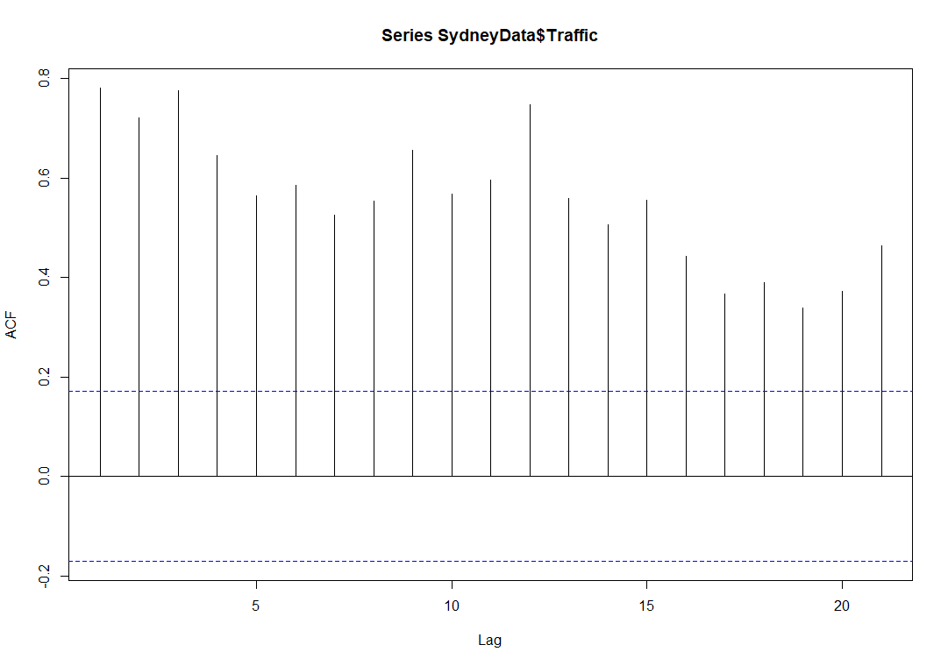
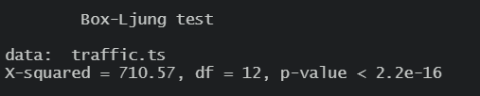
Stationarity
The time series is not stationary: we can observe it by looking at the trend: the first condition of stationarity is not respected (since the average is not constant over time, but depends on t) and there is also a seasonality.
The hypothesis of non stationarity when looking at the trend is confirmed by the following autocorrelogram: a stationary time series would have the autocorrelation fall to zero fairly quickly but for a non-stationary series, as the one we are analysing, it drops gradually.
Moreover the p-value result from the Box-Ljung test is less than 0.05, so the process cannot be approximated to a white noise

Slide 5
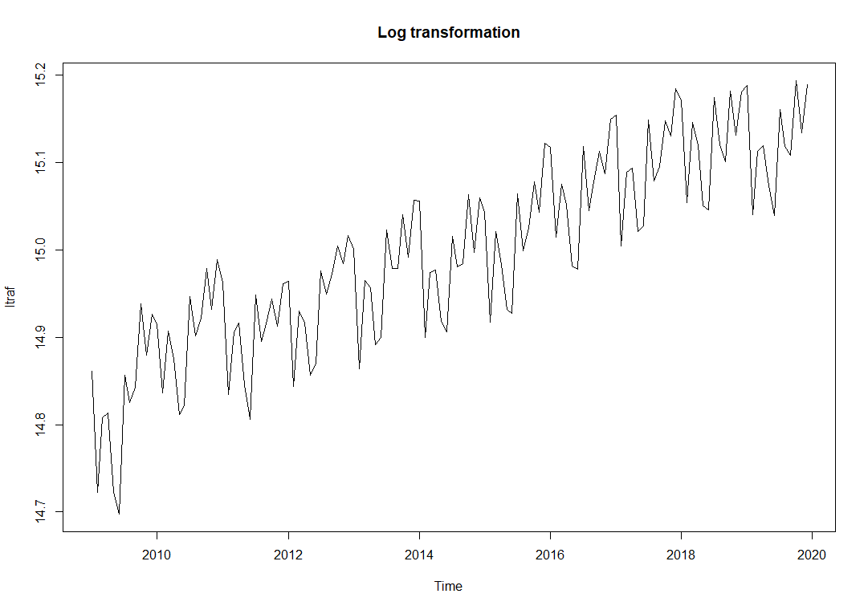
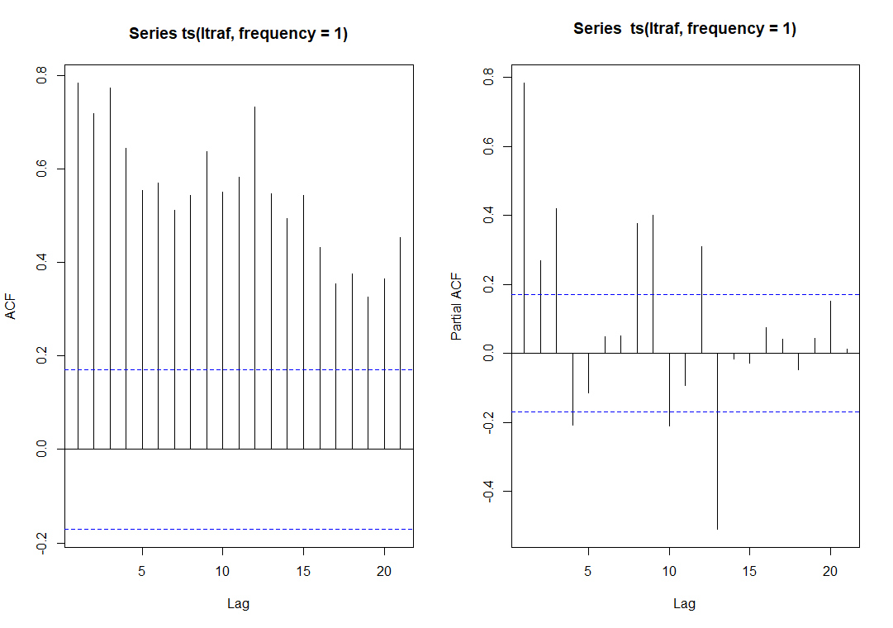
From non stationary to stationary (1)
First step: Log transformation
We performed a log transformation to eliminate the non constant variance.
As the variance was mostly constant through the years, the time series remains non stationary.

Slide 6
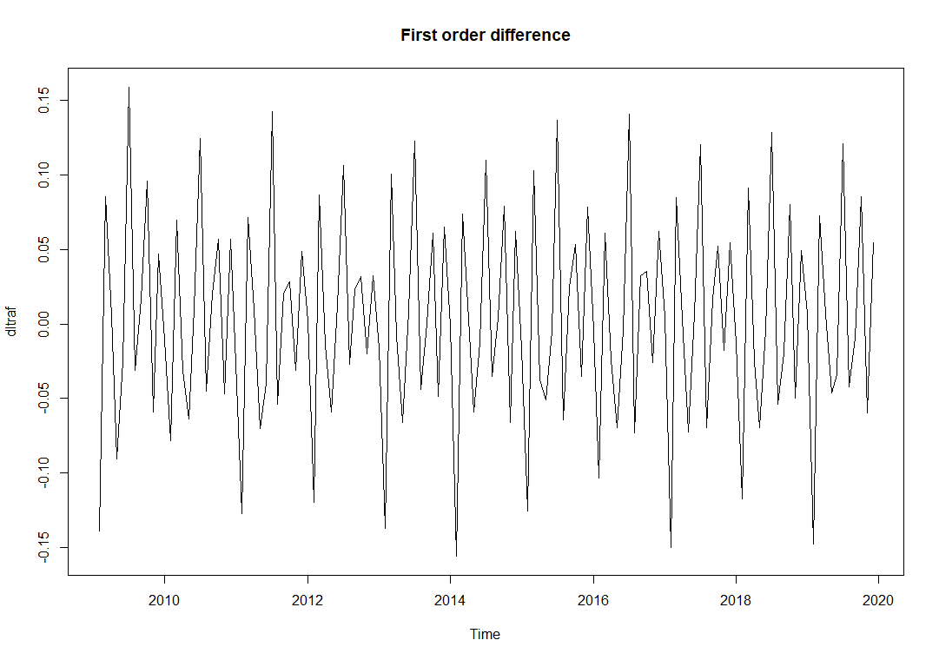
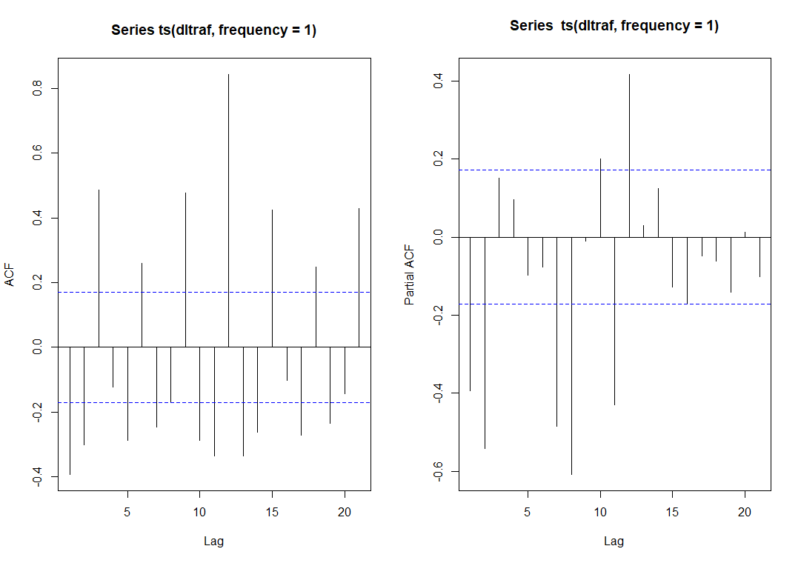
From non stationary to stationary (2)
Second step: First order difference
We performed a first order difference to eliminate the unit root, that is a stochastic trend.
Even if it seems we have reached the stationarity, from the autocorrelation plot it can be seen that seasonality is still present, so the process is still not stationary.

Slide 7
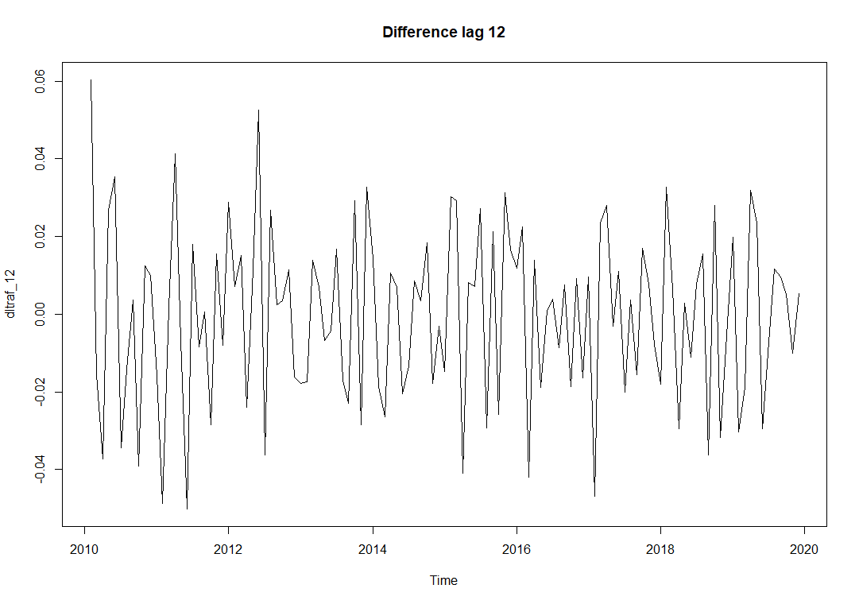
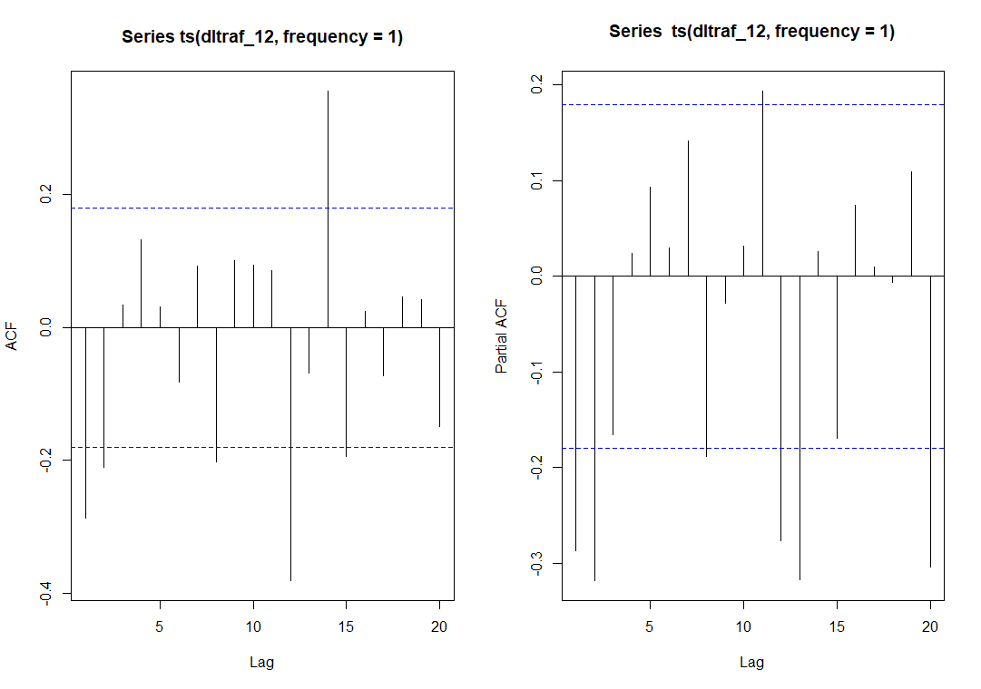
From non stationary to stationary (3)
Third step: Difference of lag 12
We performed a difference of lag 12 to eliminate the seasonality.
Even if we perfomed a difference of lag 12, some significant coefficients remain at order 12.

Slide 8
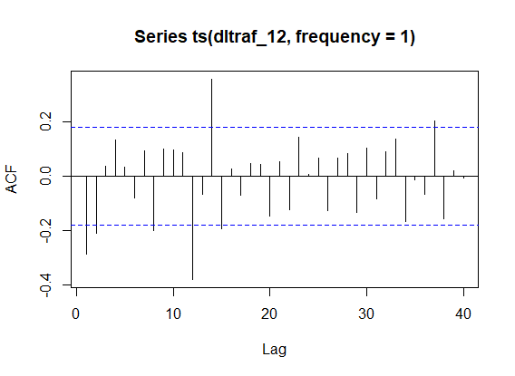
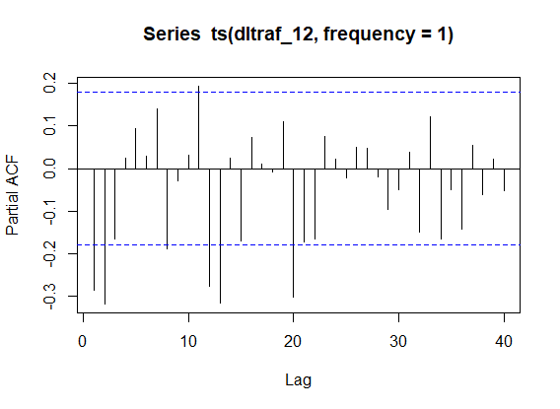
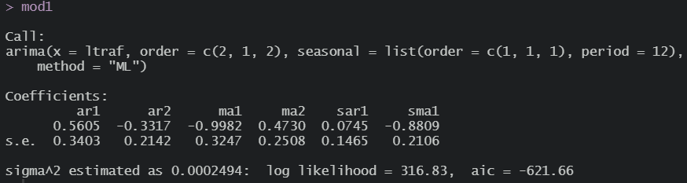
Box-Jenkins methodology (1)
First step: Identification of orders p and q
Looking at the ACF and PACF we decided to choose:
p = 2 and q = 2 because the second coefficient in both ACF and PACF is still outside the confidence interval;
P = 1 and Q = 1 because the second seasonal coefficient (lag 24) is not significant but the first (lag 12) is significant.

Slide 9
Box-Jenkins methodology (2)
Second step: Significance of the coefficients
The p-value < 0.05 for ma1 and sma1, so they are significant;
The coefficients related to AR (ar1, ar2 and sar1) and ma2 are not significant;
We remove those coefficients and re-estimate the others and see if we have a better model looking at the AIC.

Slide 10
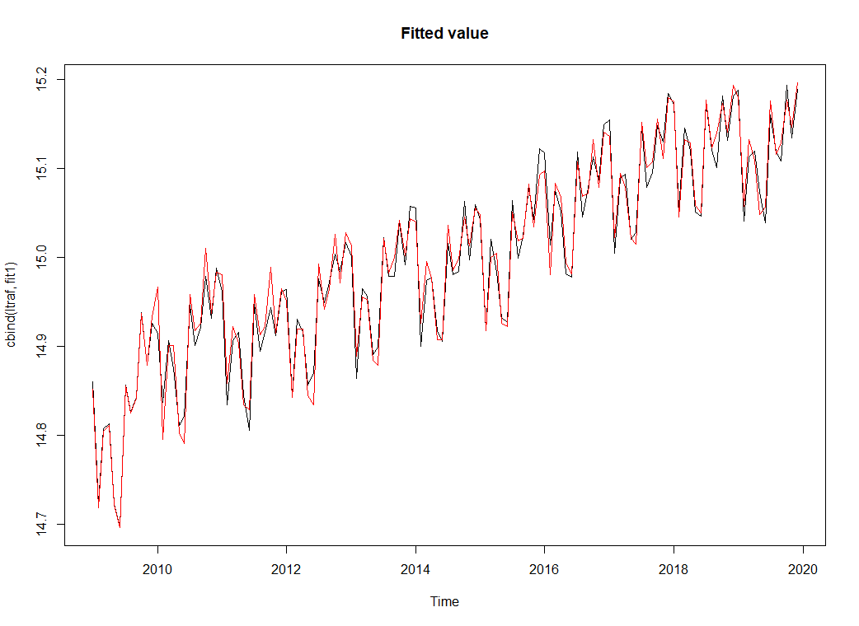
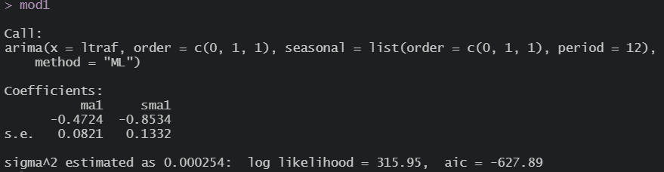

Box-Jenkins methodology (1bis – 2bis)
First step: Identifications of orders p and q
We decided to keep the coefficients ma1 and sma1:
p = P = 0
q = Q = 1
Now we have a better model because we have an AIC = -627.89 whereas before we had an AIC = -621.66
Second step: Significance of the coefficients
All the coefficients are significant as all the p-values are lower than 0.05

Slide 11

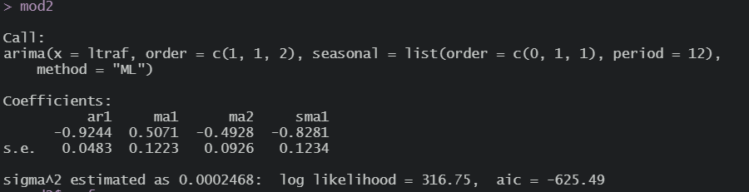
Box-Jenkins methodology (1bis – 2bis – model 2)
We decided to perform a second possible model, starting from mod1 (2, 1, 2)(1, 1) using the backward elimination: that is, without eliminating all the non-significant coefficients at once, but eliminating one at a time until we arrive at a model with all the significant coefficients.
The coefficients of this model are:
p = 1, P = 0
q = 2, Q = 1
We decided to keep the previous model because it has a better AIC.

Slide 12
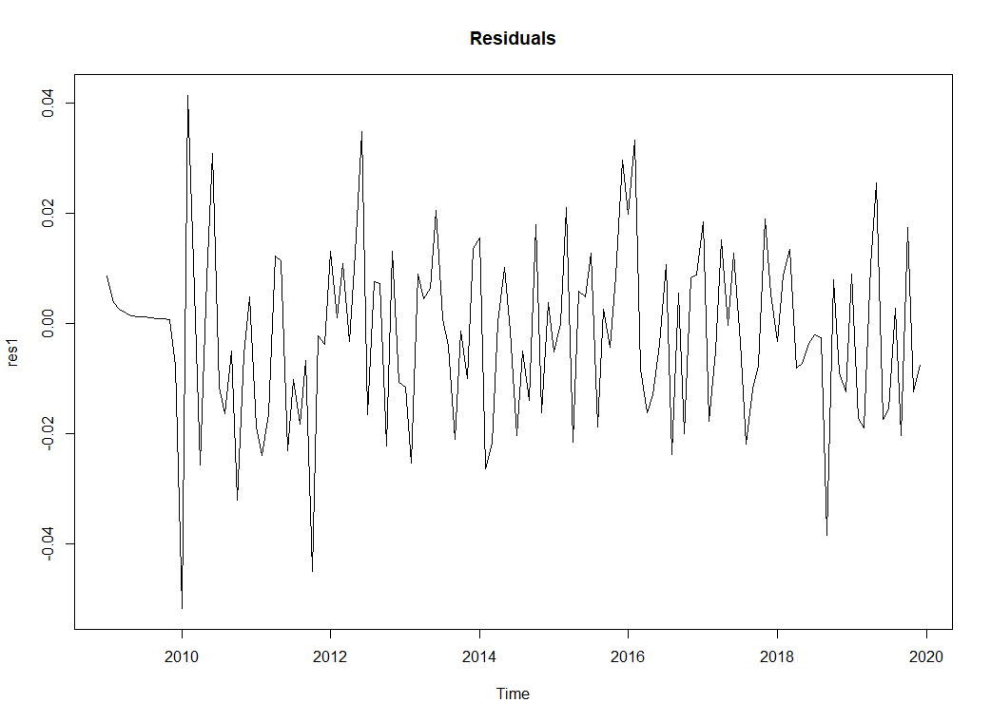





Box-Jenkins methodology (3)
Third step: Residual diagnostic (on model 1)
The Jarque-Bera test and the Shapiro-Wilk test indicate that the residuals follow a normal distribution because the p-value is greater than 0.05;
The Box-Ljung test indicates that the residuals can be approximated to a white noise process, so there is no autocorrelation (then there is not information left in the residuals which should be used in computing forecasts). This is confirmed by the ACF and PACF correlograms on the residuals;
The McLeod-Li test returns a vector of p-value, of which some elements are higher than 0.05, so the hypothesis of homoscedasticity is verified. This is confirmed by the ACF correlogram on the square root of the residuals;
The t-test on the residuals confirm that the mean of the residuals can be approximated to zero (because it remains between -2 and +2), then the forecasts are not biased.

Slide 13
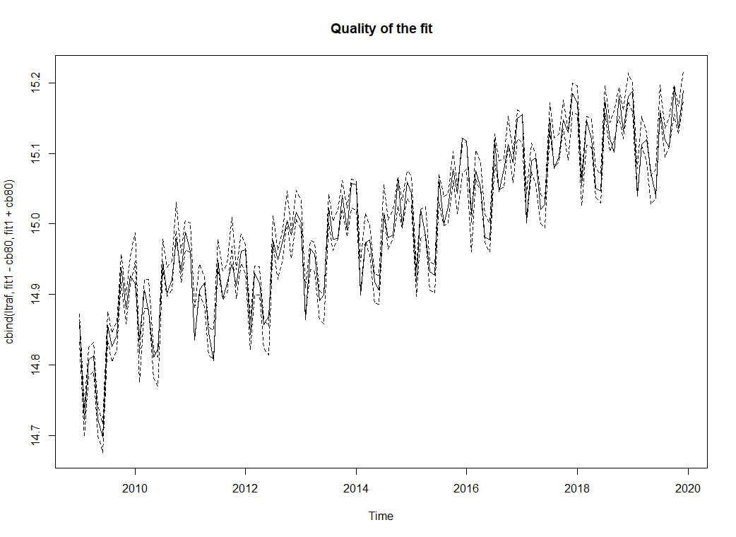

Quality of the fit
According to the graph, the quality of the fit seems to be good: the proportion of points in the confidence interval is 82.58%

Slide 14
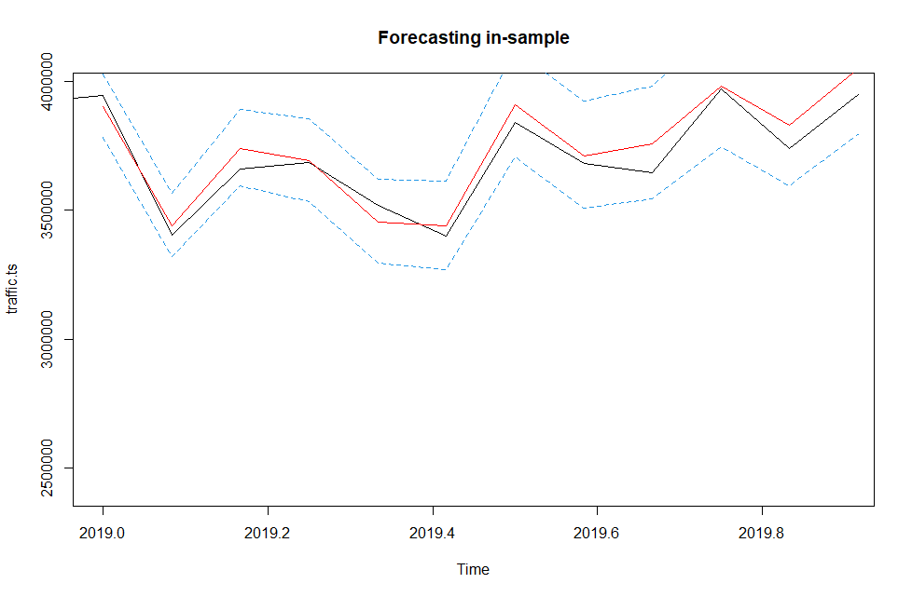
Forecasting – in sample
To test the predictive power of our model, we divided our data in two sets: a training set with data from 2009 to 2018 that we will use to predict the traffic values of 2019, and a test data set containing the real values for 2019.
According to the results below, the measures of accuracy of the model fit are all quite close to 0, which means the predictive power of the training model is high.
The Mean Absolute Percentage Error (MAPE) is 10,78% which implies that the training model is 89,22% accurate.
Red line: values predicted
Blu lines: confidence interval
Black line: real values

Slide 15
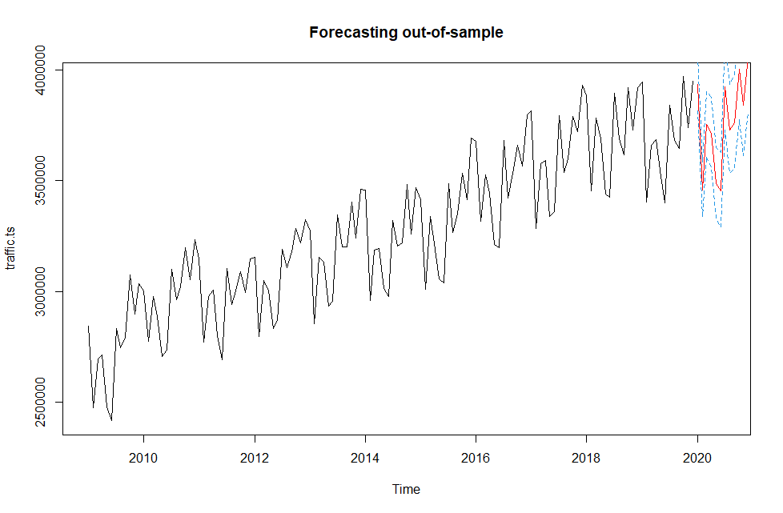
Forecasting – out of sample
These are our expected passenger numbers at Sydney Airport during the 12 months of 2020.
The red line is the exact passenger forecast.
The confidence interval in blue indicates that with 95% of the number of passengers each month falls within the range formed by the two lines.
Red line: values predicted
Blu lines: confidence interval
Black line: real values

